Slide 1

Keeping Children Safe Parent Workshop
Online Safety

Slide 2
Aims of the session
Know which apps may be high risk to your child and which ones have age restrictions.
Discuss how you can help to keep your child safe, including how to restrict the amount of time your child spends playing games online.
Q&A

Slide 3
Have a go at answering the following questions…
What is an app?
Do apps have age restrictions / recommendations?
Name some apps popular with primary school children?
What are the potential dangers of these apps?

Slide 4
True or False?
Almost 1 in 6 eight to eleven year olds have a social media profile
TRUE / FALSE?
1 in 10 children have experienced something upsetting on a social networking site.
TRUE/FALSE?
In 2017, the Internet Watch Foundation identified over 9,000 URLs containing child sexual abuse images
TRUE/FALSE?
40% of 8-17s said they have seen images and videos not suitable for their age in the last year

Slide 5
Statistics
The estimated weekly volume of internet use at home in 2013 increased with the age of the child: 6.5 hours for 3-4 year olds, 6.7 hours for 5-7 year olds, 9.2 hours for 8-11 year olds and 17.0 hours for 12-15 year olds (Ofcom)
Almost 1 in 4 of 8 to 11-year-olds and 3 in 4 of 12 to 15-year-olds has a social media profile
34% of children aged 8-12 have a profile on sites that require users to be aged 13 or over e.g. Facebook (Childnet)
1 in 3 internet users are children
1 in 4 children have experienced something upsetting on a social networking site.
Around 1 in 8 young people have been bullied on social media
In 2017, the Internet Watch Foundation identified over 78,000 URLs containing child sexual abuse images

Slide 6
Children Online
Potential Risks
Cyber bullying
Grooming
Inappropriate websites
Losing control over pictures and video / Giving out too much information online
Viruses, hacking and security
Addiction / too much screen time

Slide 7
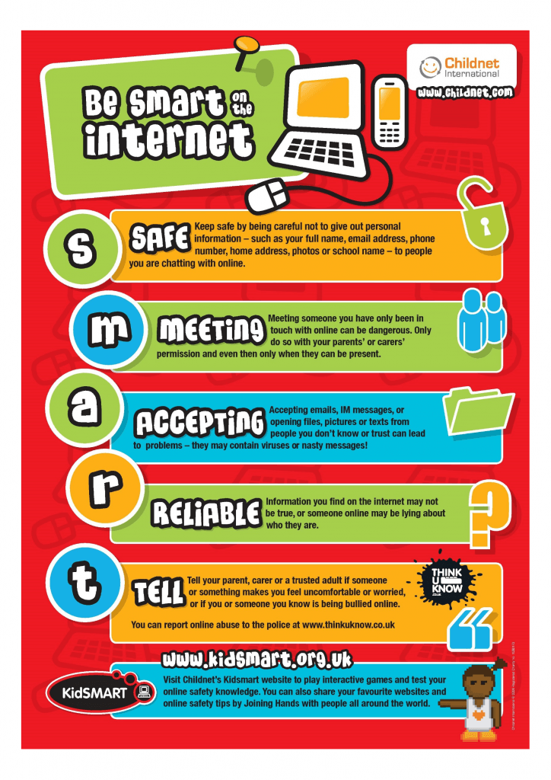
What we do in school to educate our children to stay safe online…

Slide 8
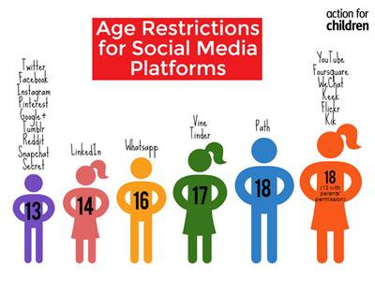

Slide 9


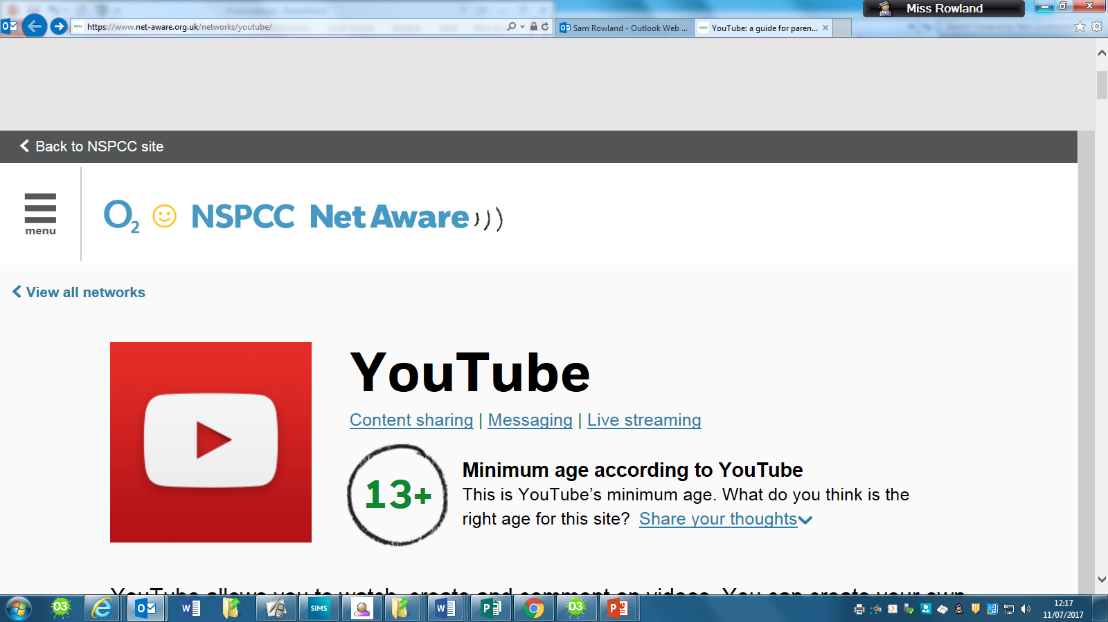

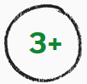
Snapchat
Age Restrictions
Snapchat is an app that lets you send a photo, short video or message to your contacts. The ‘snap’ appears on screen for up to 10 seconds before disappearing, although it can be ‘screenshotted’. There’s also a feature called Snapchat Story that lets you share snaps in a sequence for up to 24 hours.
Pokémon GO allows you to find Pokémon characters and catch them to add to your collection. The map is based on where you are standing (in real life).
Young people say:
“If your privacy's not on, anyone can follow you.” - Girl, 13
“If you turn off location settings, you can’t use filters, so you have to keep location settings on.” - Girl, 13
“I don't know how to change the settings.” - Girl, 14
66% of young people who reviewed Snapchat said they know how to change their privacy settings on this site.
57% said they know how to turn off their location settings.
Young people say:
19% of young people who reviewed Pokémon GO said they know how to change their privacy settings on this site.
19% said they know how to turn off their location settings.
What do children and young people say to look out for:
In-app purchases encourage you to spend money
It can be an addictive game
It uses your location and allows the possibility of interacting with other players in the real world, including going to inappropriate or risky places
Parents say:
“Signing up is far too easy and it is very easy for kids to pretend that they are older.” - Father of girls aged 4 and 13
What do children and young people say to look out for:
32% of the children and young people who reviewed Snapchat thought that it can be risky. The main reasons they gave were:
Strangers adding you
You can’t control what you see when you open a Snapchat from someone else
People can screenshot your Snapchats and then share them

Slide 10
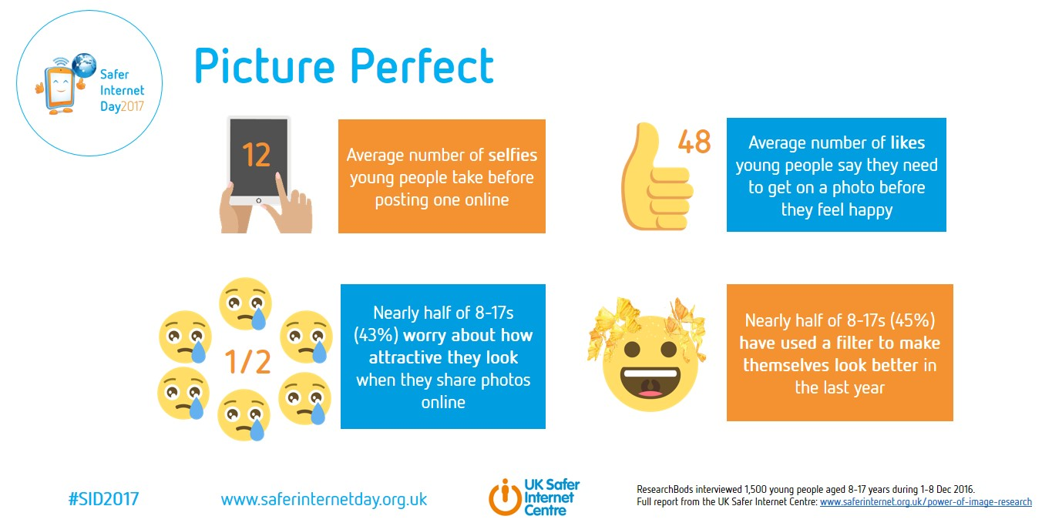
Self Esteem…

Slide 11




Age Restrictions
Facebook is a social network which lets you create a page about yourself. You can add friends, write on people’s pages, share photos and videos including live videos. Facebook Messenger allows you to instant message in group chats or one to one. Facebook allows live streaming.
YouTube allows you to watch, create and comment on videos. You can create your own YouTube account, create a music playlist, and even create your own channel, which means you will have a public profile. YouTube allows live streaming.
Thinks to look out for:
Talking to strangers, or having strangers view their profile
Lack of privacy and a feeling that anyone can find and add them
Adverts and pop-ups which aren’t appropriate for young people
Coming across disturbing or upsetting videos
Hackers
What do children and young people say to look out for:
26% of the children and young people who reviewed YouTube thought that it can be risky. Key things they mentioned were:
Some videos don’t contain age appropriate content
Mean comments on videos
Adverts, these can be annoying and sometimes inappropriate
Parents say:
“It's too easy for underage people to register.” - Father of children aged 16 and 18
Young people say:
76% of young people who reviewed Facebook said they know how to report on this site.
85% said they know how to block someone.
Find out about more apps here: https://www.net-aware.org.uk/networks/?order=title

Slide 12
Dangerous Apps
1. SeekingArrangement.com
2. Yik Yak
3. Ask.fm
4. Kik Messenger
5. Omegle
6. Whisper
7. Yubo

Slide 13
Risks of Gaming
Many online games have communication features which allow their users to interact anonymously e.g. Minecraft (all devices) and World of Warcraft (PC)
Cyberbullies may harass fellow gamers and online scam artists may promise virtual goods in an effort to get credit card information e.g. World of Warcraft
Some game consoles allow internet access as well, so it is important to be aware of their communication features.

Slide 14
Parental Controls
Gaming Devices
Parental controls can also be set up on games consoles, such as Playstation, Xbox and Nintendo Wii.
Restrict games based on age rating.
Restrict time spent e.g. On the Xbox 360 activate the “Family Timer” to limit the total amount.
Control your child’s friend requests so you know who they’re playing with online.
Restrict online user-to-user communication and the exchange of user-generated content.

Slide 15
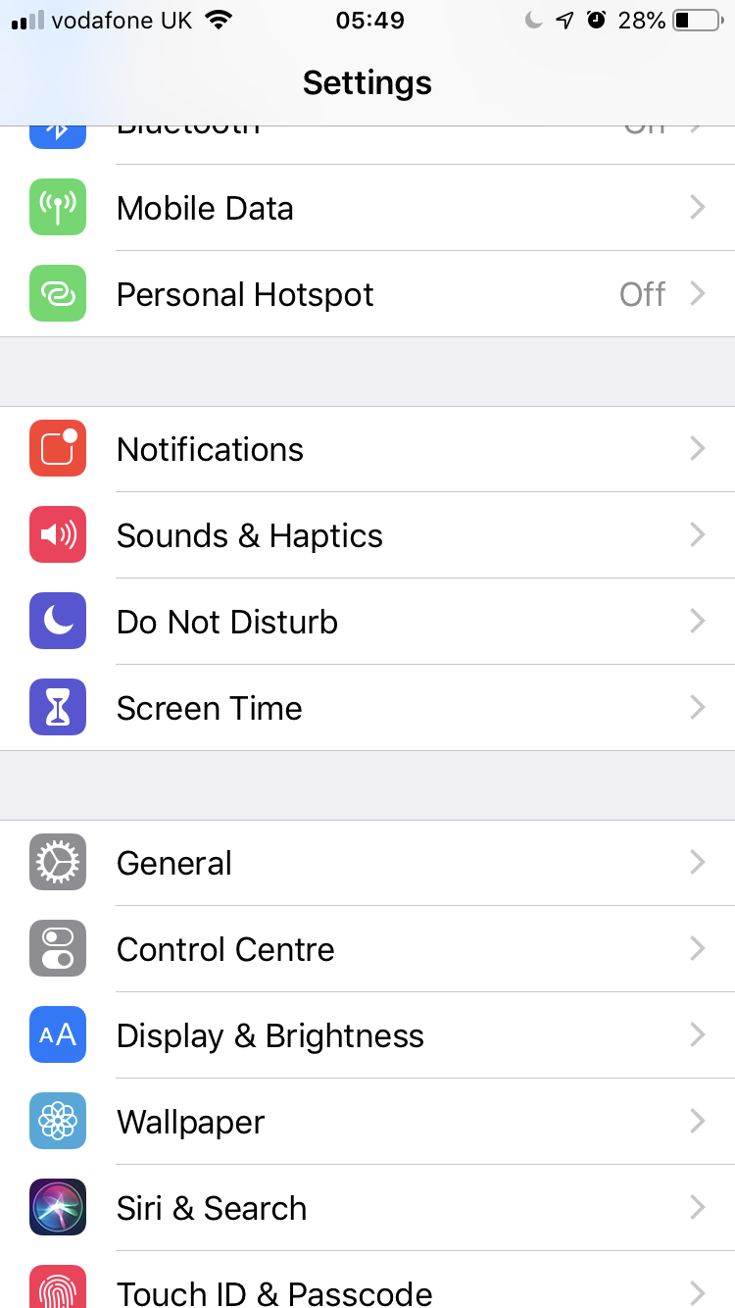
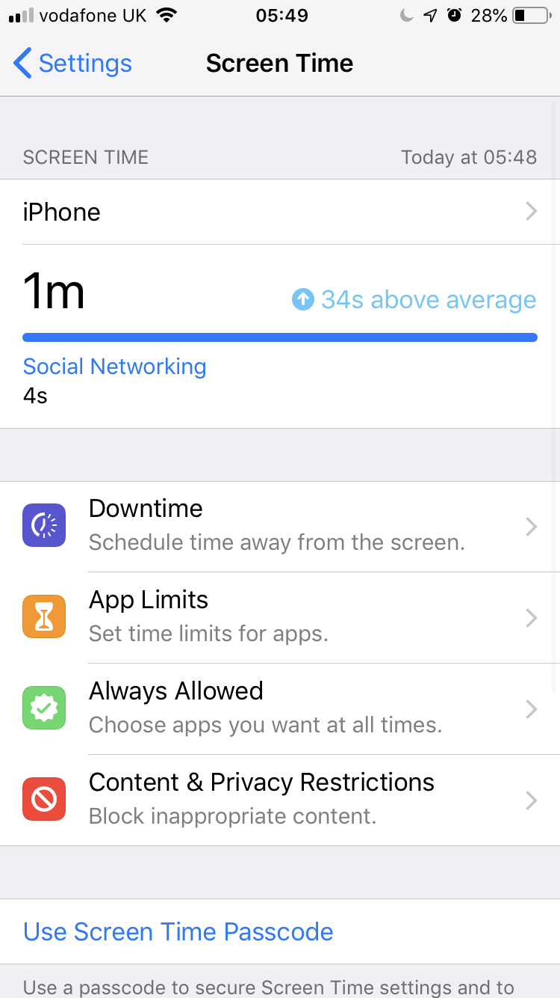
Preventing in-app purchases – and potentially saving you lots of money…

Slide 16
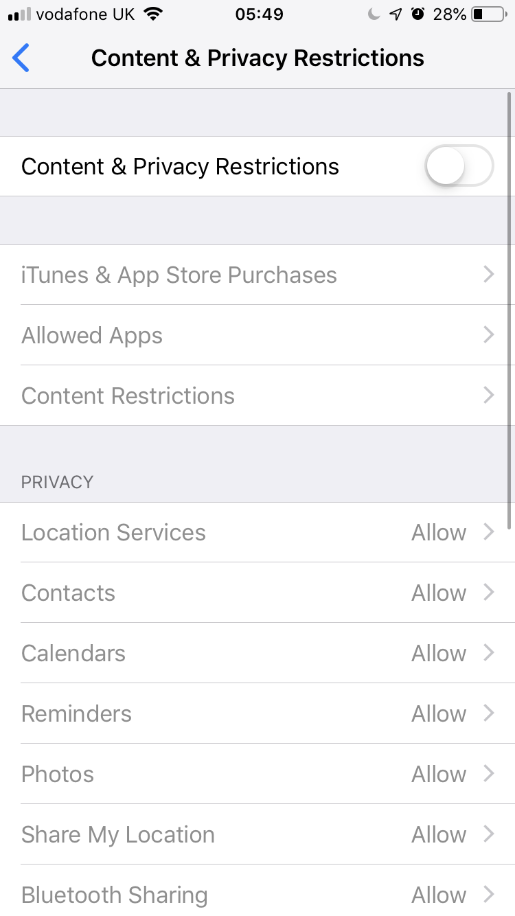
Preventing in-app purchases – and potentially saving you lots of money…

Slide 17
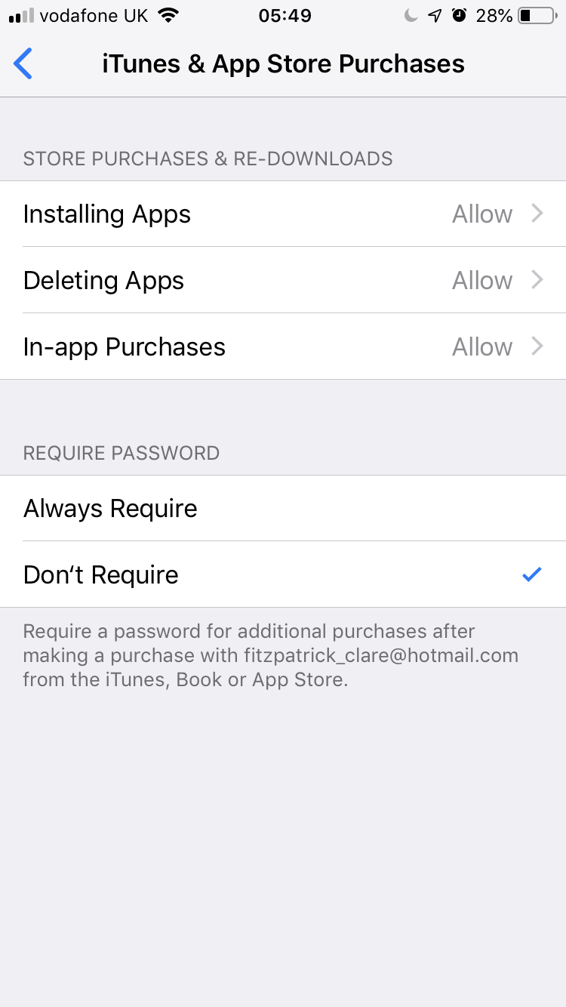
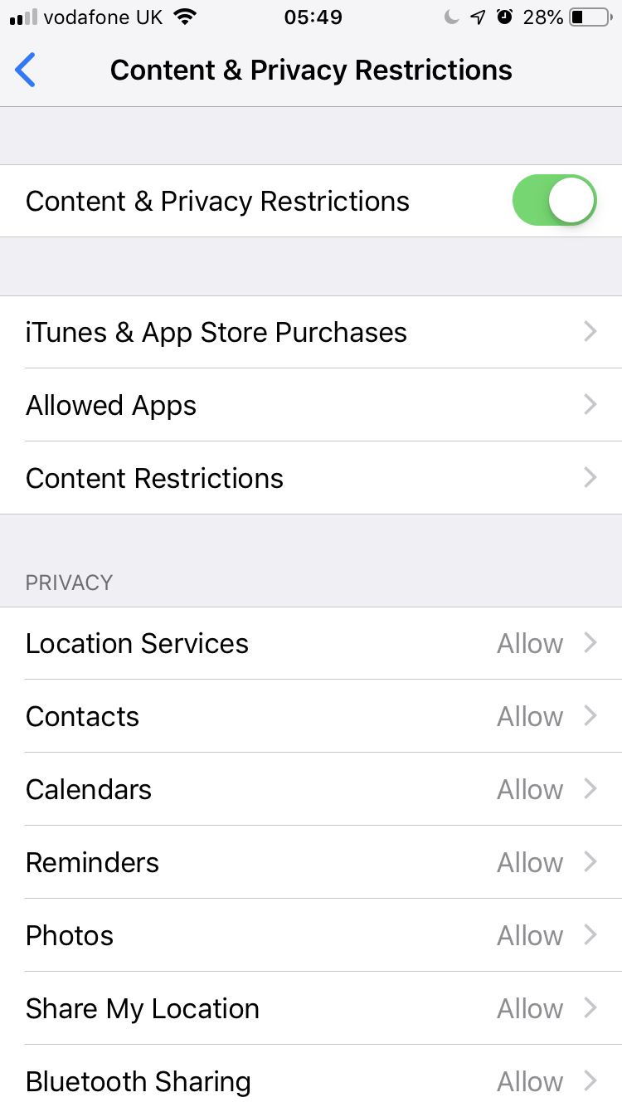
Preventing in-app purchases – and potentially saving you lots of money…

Slide 18
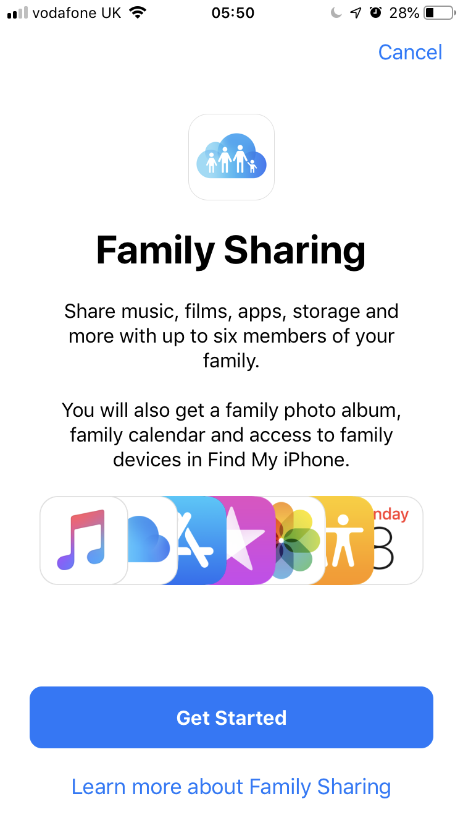
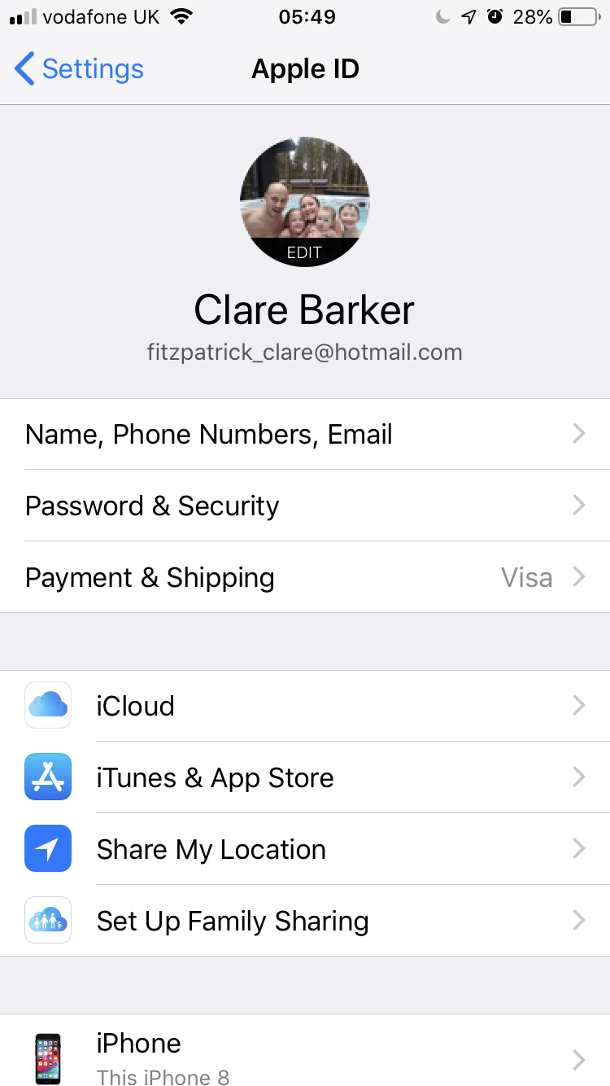
Family Sharing – controlling what they download…

Slide 19
Parental Controls and Being in Control
Do your research! Before purchasing or downloading a game or app for your child, check out sights like ‘ Common Sense Media’ for app reviews and advice. CHECK AGE RATINGS.
Consider YouTube Kids as a safer option for younger children. YouTube Kids allows parents to set an age level and time limits.
The O2 NSPCC Online Safety Helpline can help you to set up parental controls, adjust privacy settings or get advice on social networks. You can call them free on 0808 800 5002.

