Slide 1

Year 6 SATs 2024
Parent Meeting

Slide 2
What are the SATs?
SATs are the Standardised Assessment Tests that are given to children at the end of Key Stage 2.
The SATs take place over four days, starting on Monday 13th May ending on Thursday 16th May.
The SATs papers consist of:
  Grammar, punctuation and spelling (paper 1: GPS) – Monday
  Grammar, punctuation and spelling (paper 2: Spelling) – Monday
  Reading – Tuesday
  Maths (paper 1: Arithmetic) – Wednesday
  Maths (paper 2: Reasoning) – Wednesday
  Maths (paper 3: Reasoning) – Thursday
Writing is assessed using evidence collected throughout Year 6. There is no Year 6 SATs writing test.

Slide 3
When and how the SATs are completed
The tests take place during normal school hours, under exam conditions.
Children are not allowed to talk to each other from the moment the assessments are handed out until they are collected at the end of the test.
After the tests are completed, the papers are sent away to be marked externally.
The results are then sent to the school in July.
Each test lasts no longer than 60 minutes:
  Spelling, punctuation and grammar (paper 1: Grammar/ Punctuation) – 45 minutes
  Spelling, punctuation and grammar (paper 2: Spelling) – 15 minutes
  Reading – 60 minutes
  Maths (paper 1: Arithmetic) – 30 minutes
  Maths (paper 2: Reasoning) – 40 minutes
  Maths (paper 3: Reasoning) – 40 minutes

Slide 4
Specific arrangements for SATs
Children with additional needs (who have similar support as part of day-to-day learning in school) may be allotted specific arrangements, including:
Additional (extra) time;
An adult to read for them (except the Reading test)
In Maths and SPAG the children can ask for a question to be read to them, but not explained to them. In Maths, words and numbers may be read but symbols cannot be read.
Notes:
The DfE Key Stage 2 access arrangements guidance (https://assets.publishing.service.gov.uk/government/uploads/system/uploads/attachment_data/file/1109963/2023_key_stage_2_access_arrangements_guidance.pdf) gives more details on this, including which arrangements need prior permission.
It should be noted that there are cases when pupils can have access to multiple arrangements (e.g. addition time and a scribe). These are detailed in the above document.
Also note, any pupil can ask for a question to be read to them, though not explained to them. In mathematics, words and numbers may be read but mathematical symbols cannot be read.

Slide 5
The results
Tests are marked externally.
Scaled scores range from 80 to 120.
A scaled score of 100 or more shows the pupil is meeting the National Standard.
Notes:
This year, the test results will be available on the PAG on Tuesday 4th July (https://assets.publishing.service.gov.uk/government/uploads/system/uploads/attachment_data/file/1110107/2023_key_stage_2_assessment_and_reporting_arrangements.pdf section 9.1)
There is no separate test that would indicate a pupil is working above the national standard.
A scaled score of less than 99 would indicate a pupil is working below the national standard.
To have a scaled score, pupils must have a minimum raw score (determined each year). If the pupil does not achieve the minimum raw score, they have not demonstrated sufficient understanding of the KS2 curriculum in the subject.

Slide 6
Grammar, Punctuation and Spelling:
Grammar, punctuation and spelling consists of two papers.
Paper 1 focuses on all three elements (grammar, punctuation and spelling or GPS). The paper lasts for 45 minutes.
Paper 2 consists of a spelling test only. It should take approximately 15 minutes, although this is not a set amount of time (pupils should be given as much time as they need to complete the test).

Slide 7
Reading:
There is one reading test that lasts for 60 minutes.
The test is designed to measure if the children’s comprehension of age-appropriate reading material meets the national standard. There are three different set texts for children to read. These could be any combination of non-fiction, fiction and/ or poetry.

Slide 8
Maths:
The maths assessments consist of three tests.
Paper 1: Arithmetic (30 minutes) –
Paper 2: Reasoning (40 minutes) –
Paper 3: Reasoning (40 minutes) –

Slide 9
Supporting your child in preparing for the SATs
Firstly, a positive attitude goes a long way. Give them as much encouragement and support as you can (but we don’t need to tell you that)!
Tips:
You can use past papers as they are used in school to prepare the children (online)
https://www.cgpbooks.co.uk/resources/cgp-s-free-online-10-minute-tests/free-primary-spag-online-10-minute-tests-years-1-t
Give your child a quiet, distraction free space to complete homework or study.
Give your child time to go outside and reduce screen time.
Ensure your child is eating and drinking well and getting a good amount of sleep.
Plan something nice and fun for the weekends before and after SATs. This will help them to relax before the SATs and give them something to look forward to after.
Attend breakfast club each morning
Notes:
Encourage parents not to use past papers at home. If they want to use past papers with tutors, suggest that they could take copies of completed test home to work through with tutors. This may help them to work through specific misunderstandings.

Slide 10
Supporting your child in preparing for the SATs
Further tips:
Keep revision light. Going over key skills (times tables, reading!, spelling rules/patterns) –
If you’re looking to support your child further with maths at home, there are lots of good websites with free Year 6 revision resources. Start with thirdspacelearning.com/blog/category/for-parents/ or register free for the Third Space Learning Maths Hub (mathshub.thirdspacelearning.com)

Slide 11
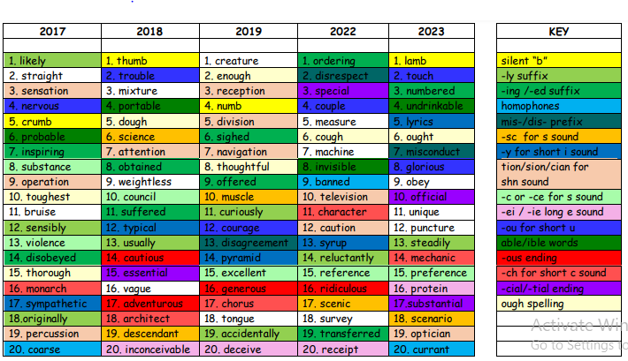

Slide 12
Things to remember about SATs
SATs focus on what children know about Maths and English.
They will not reflect how talented they are at science, geography, art, PE…, and they certainly won’t highlight all of their amazing personal characteristics.
SATs don’t tell the whole story.
Their results will say if they did or did not meet a certain standard but not necessarily by what margin. These thresholds change each year according to the overall national performance, so what was classed as ‘meeting the expected standard’ this year might not be the same as last year. Your school may be able to provide you with more detailed feedback.
SATs are only four days out of a whole Primary School career.
In reality, there’s one or two papers each day that last 30 to 60 minutes.

