Slide 1

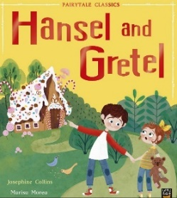

Year 2 Summer Term
Narrative:
Traditional tales
Hansel and Gretel
by Josephine Collins
Synopsis
This is a traditional tale about two young children who are abandoned in the woods by their Father and Stepmother. Eventually the children find a house made of sweets but the owner of the house is actually a wicked witch who traps them. How will the children defeat the witch and escape?
Why is this a high quality text in Year 2?
Dialogue is used to move the action on or to heighten empathy for a character.
Subordination and coordination
Expanded noun phrases
2A sentences
Wider range of verbs and adjectives
Higher level vocab
Rationale
This is a lesser known traditional tale that builds on the experiences from Year 1. It has relatable characters and the plot is clear and predictable. It allows for writing a simple narrative with an aspect of innovation.

Slide 2
Year 2 Summer Term
Narrative:
traditional tale
Hansel and Gretel
by Josephine Collins
Fantastic Features
Writing Outcome - A new ending for the text.
Subordination and coordination: and, but, because
Expanded noun phrases
2A sentences
Verbs
Synonyms
Higher level vocab
Writing Outcome –
A new ending for the text.
A letter.
Vocabulary
crept, peaked, peered, thrown, crafty, clever, ingenious, brave

